Slide 1

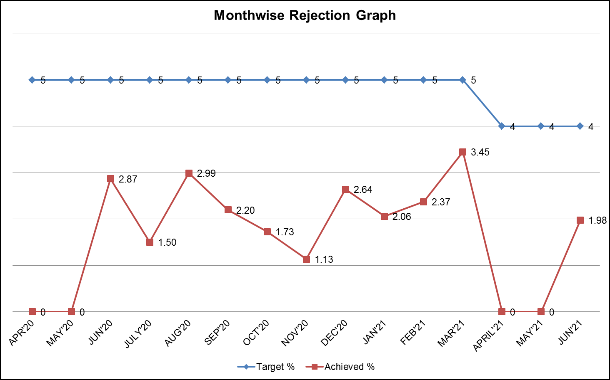
IQC
Remark:
April 21 – No Lot Received
May 21 – No Lot Received

Slide 2
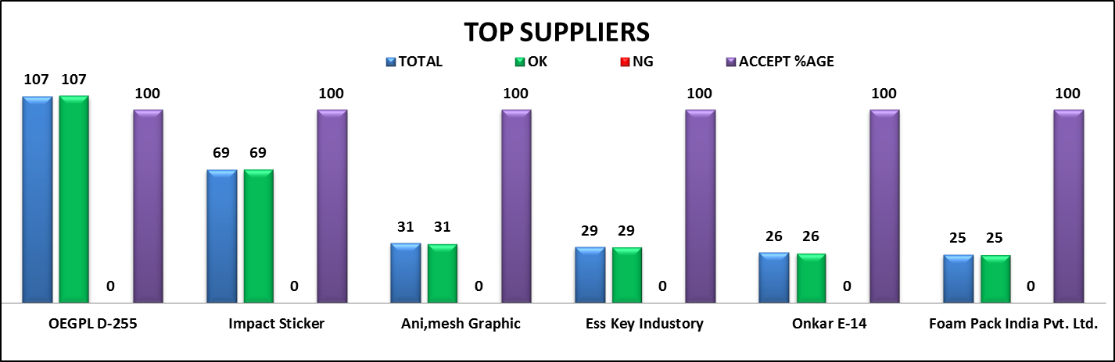
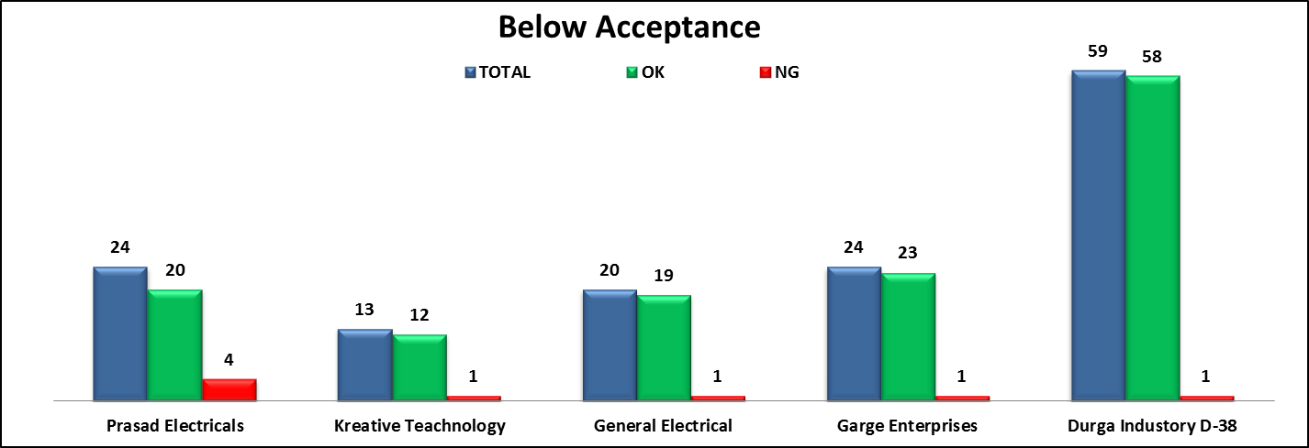
IQC
June 2021

Slide 3
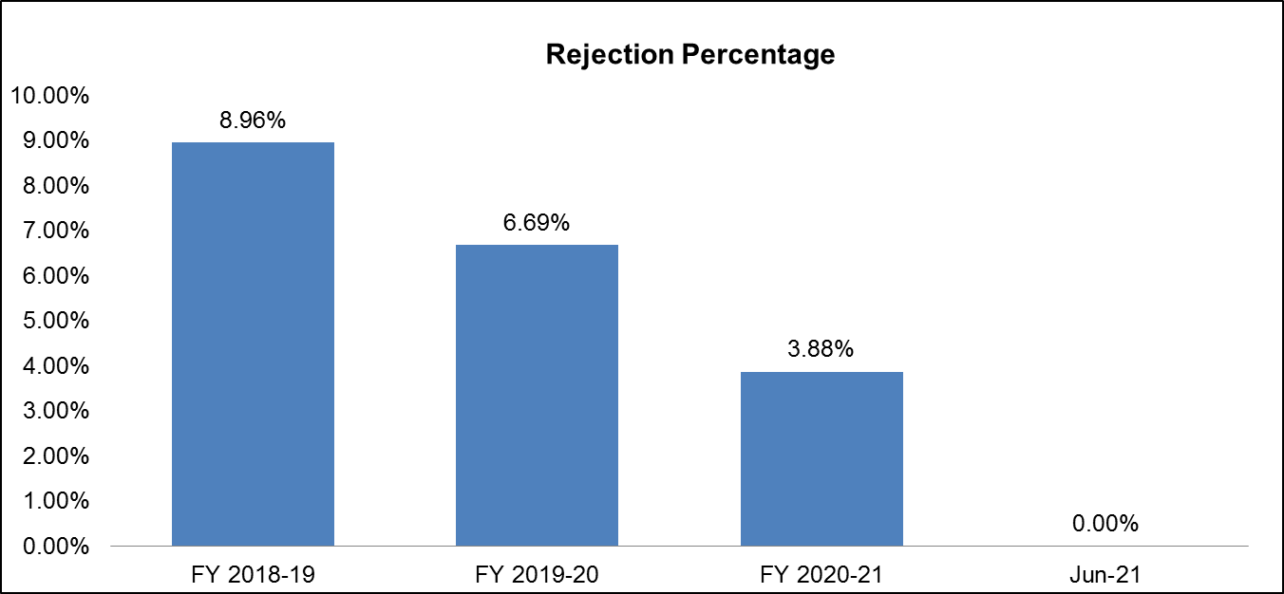
PDI
Rejection Percentage
FY 2018-19 | FY 2019-20 | FY 2020-21 | Jun-21
8.96% | 6.69% | 3.88% | 0.00%

Slide 4
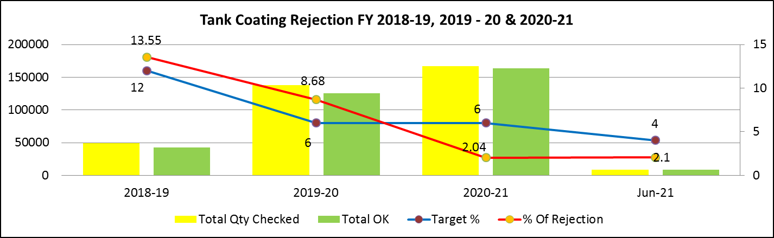
Process Rejection Trend Tank Coating
Coating Rejection
Month | Total Qty Checked | Total OK | Total Rejection | Target % | % Of Rejection
2018-19 | 49370 | 42682 | 6688 | 12 | 13.55
2019-20 | 137632 | 125688 | 11944 | 6 | 8.68
2020-21 | 167269 | 163852 | 3410 | 6 | 2.04
Jun-21 | 8484 | 8306 | 174 | 4 | 2.1
Remark:
April 21 – No Production
May 21 – No Production

Slide 5
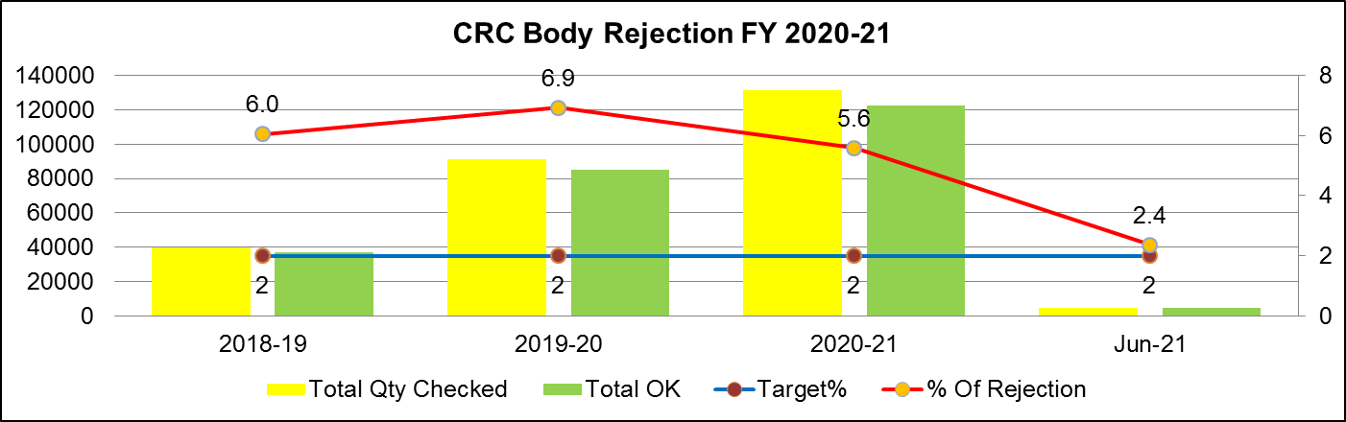
CRC Body Rejection
CRC Body
Month | Total Qty Checked | Total OK | Total Rejection | Target% | % Of Rejection
2018-19 | 39585 | 37191 | 2394 | 2 | 6.0
2019-20 | 91202 | 84889 | 6313 | 2 | 6.9
2020-21 | 131162 | 122199 | 7337 | 2 | 5.6
Jun-21 | 4733 | 4621 | 112 | 2 | 2.4
Remark:
April 21 – No Production
May 21 – No Production

Slide 6
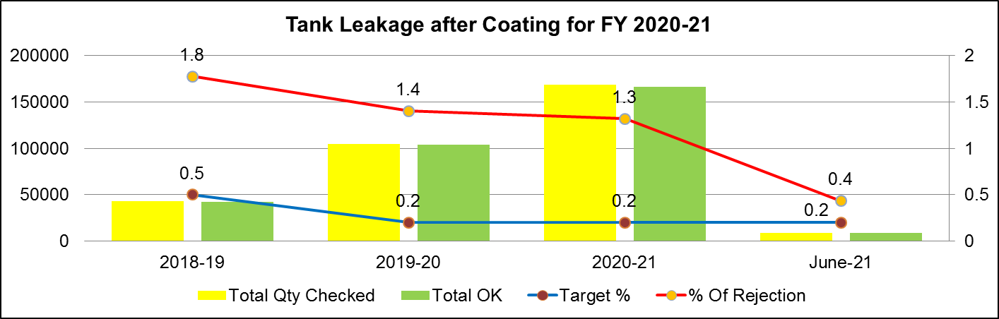
Process Rejection Trend Element Leakage
Element Leakage
Month | Total Qty Checked | Total OK | Total Rejection | Target % | % Of Rejection
2018-19 | 42958 | 42196 | 762 | 0.5 | 1.8
2019-20 | 105073 | 103601 | 1472 | 0.2 | 1.4
2020-21 | 168799 | 166571 | 2228 | 0.2 | 1.3
June-21 | 8994 | 8955 | 39 | 0.2 | 0.4
Remark:
April 21 – No Production
May 21 – No Production

Slide 7
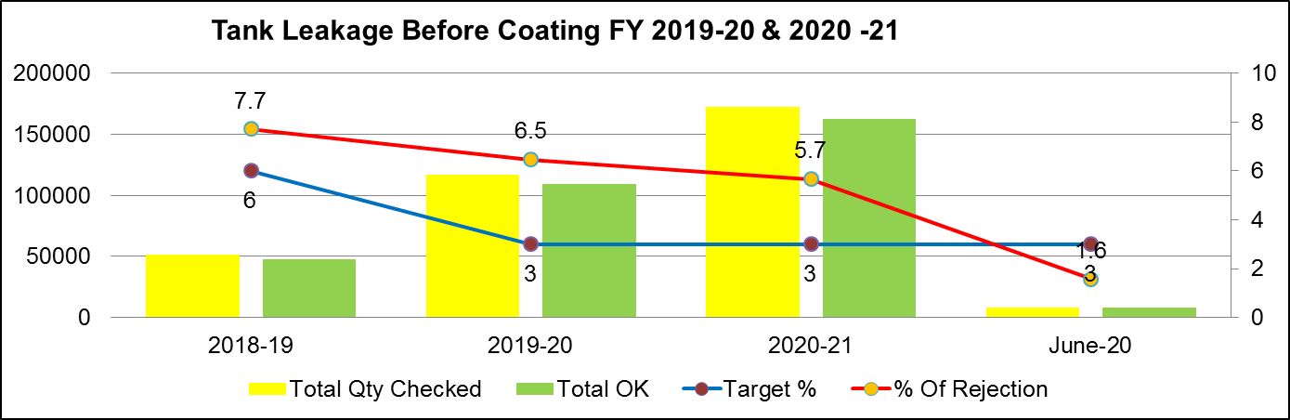
Tank Leakage before Coating
Tank Leakage before Coating
Month | Total Qty Checked | Total OK | Total Rejection | Target % | % Of Rejection
2018-19 | 51546 | 47572 | 3974 | 6 | 7.7
2019-20 | 116676 | 109142 | 7534 | 3 | 6.5
2020-21 | 172267 | 162503 | 9764 | 3 | 5.7
June-20 | 8385 | 8252 | 133 | 3 | 1.6
Remark:
April 21 – No Production
May 21 – No Production

